Slide 1
AUR 2024
A Poem and A Dance
Ashley Davidoff MD

Slide 2
Dedication to My Parents The Powers of the Foot and Ode to the X-Ray

Slide 3
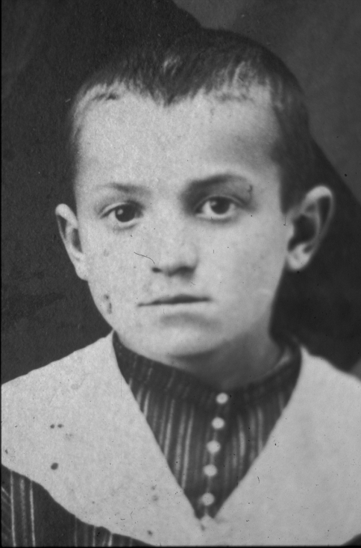
Dad
He was 6 years old in his native Lithuania
A shy boyish smile in a family photograph

Slide 4
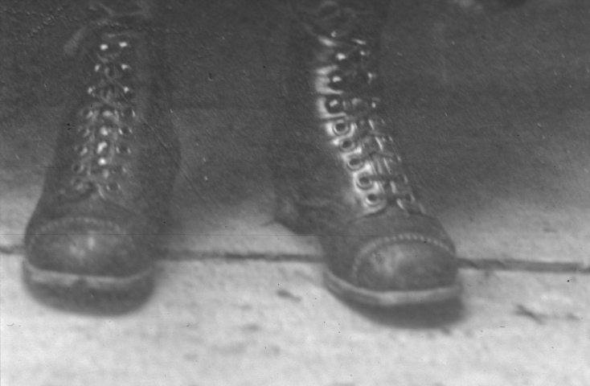
And I noticed his boots-
– With both feet sitting squarely on the ground
– that was my father
…

Slide 5
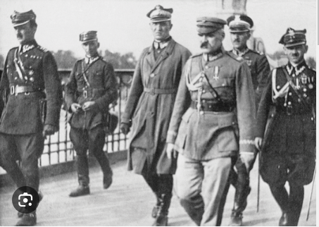
And then they came…
So the family fled eastward

Slide 6
And then westward…
A father and a brother died in the heat of a Russian idea and its winter..
And again they came
So the family packed up and fled
A new country, (South Africa)
A new hope

Slide 7
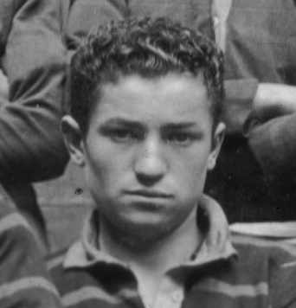
Going to school with other boys
A shy smile in the school rugby team

Slide 8
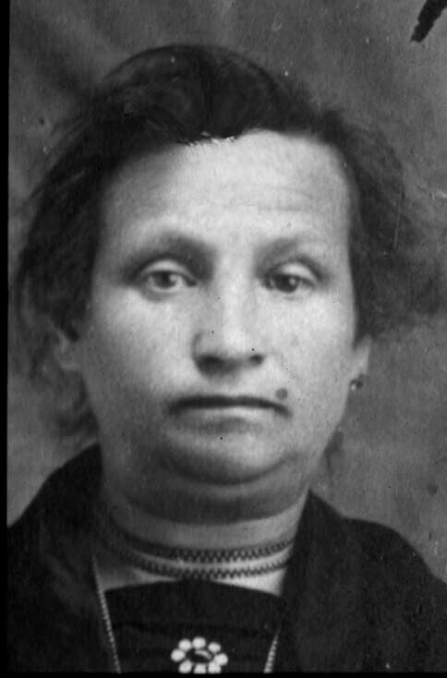
Hard times for the family
Walking many miles to save pennies…
To make pennies
It all helped the small family of brothers 4
Totally dedicated to their single mother
Who in turn was
Totally dedicated to her 4 sons

Slide 9
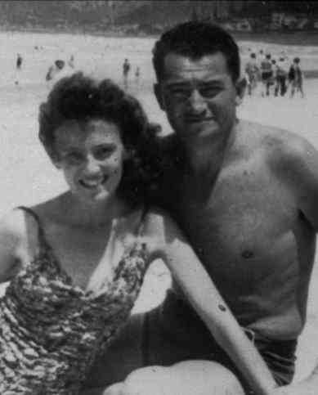
At first shoe making was slow- and cumbersome of course
And then a new life with an amazing wife, Joyce Stein

Slide 10
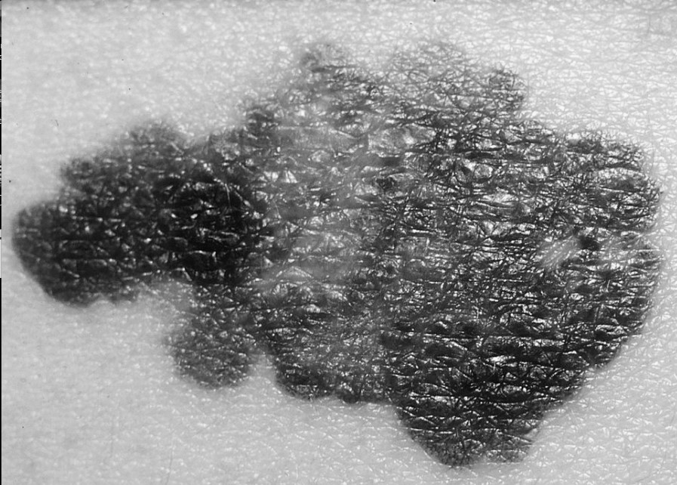
Just a small black nodule on the calf of his leg
No – not very good
The large glands contained the same foreboding
“Shoe business for sale”… “Sold”

Slide 11
And then it descended
We cried, we cried a lot
I walked along with five others
Two in front
Three to my side
And my mother and brothers were all there …
And I remembered his boots….
And I hope to stand square on the ground, …and
With warmth and goodness
I hope to walk in his footsteps

Slide 12
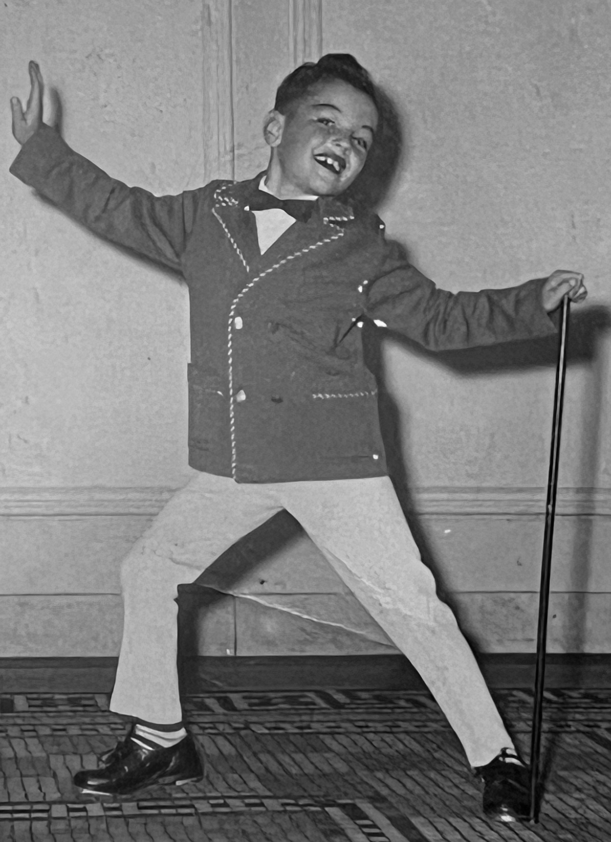
And Now for Some Fun

Slide 13
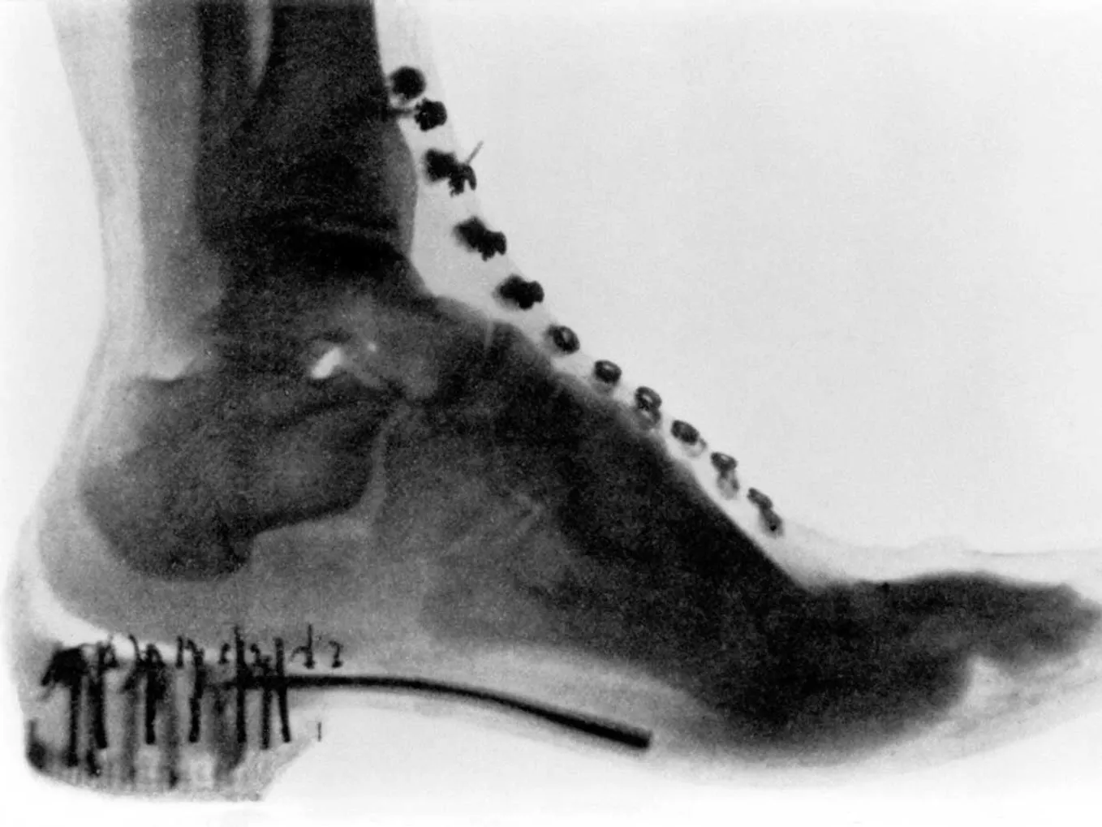
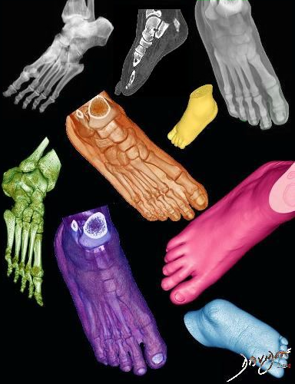
X-Ray Blues
X-Ray Blues Everybody's singing
The X-ray Blues
The whole room is ringing
My loving gal,
Sweet as can be
But the doggone fool
Turned sour on me
I'm so unhappy I feel so bad I could lay me down and die
You could say what you choose
But I’m all confused
I’ve got the sweet-sweet X-Ray Blues More X-rays
I’ve got the sweet-sweet
X-Ray Blues
Notes:
"Sugar Blues" is a song written in 1919 by Clarence Williams with words by Lucy Fletcher. It was recorded for the first time by Leona Williams and her Dixie Band in August 1922.^{[1]} Sara Martin recorded it with Williams at the piano later that year.^{[2]} It was later recorded by Bob Wills and his Texas Playboys, Fats Waller, and Ella Fitzgerald with Chick Webb and his Orchestra (1939) and others.
The song became popular in 1936 as the trumpeter Clyde McCoy's theme song, featuring the sound of the growling wah-wah mute.^{[3]} As an instrumental, it was also recorded by Count Basie, Johnny Mercer, the Preservation Hall Jazz Band, Berl Olswanger and his Orchestra.
Sugar Blues https://www.youtube.com/watch?v=SjemjB3kgAM from 0 to 42 or 2:19 to 3:08
Clyde McCoy
Contemporary Version (Chloe Feoranzo) https://www.youtube.com/watch?v=5cq16Yt9po8

