Slide 1
Incidental Coronary Findings on Chest CT With Focus on Left Main Disease
Wanda Wu
Dr. Ashley Davidoff MD
Notes:
[Caption]
N/A
[Keywords]
TITLE: Incidental Coronary Findings on Chest CT With Focus on Left Main Disease
Reference Structure: coronary arteries
Images: n/a
Findings: n/a
Disease or Diagnosis:
Complications:
Final Diagnosis Path:
Modality and Sequence:
Author-Editor: Wanda Wu MS4, Ashley Davidoff MD
Acknowledgements:
Modifiers:

Slide 2
CASE HISTORY
78-year-old female with known history of well-controlled diabetes, hypertension, hyperlipidemia, 30-pack year smoking history (quit 1986), and obesity (class 2) presents for scheduled CT chest without contrast for follow-up of an asymptomatic 3mm nodule at the right lung apex seen on CT C-spine.
Notes:
[Caption]
78-year-old female with known history of well-controlled diabetes, hypertension, hyperlipidemia, 30-pack year smoking history (quit 1986), and obesity (class 2) presents for scheduled CT chest without contrast for follow-up of an asymptomatic 3mm nodule at the right lung apex seen on CT C-spine.
[Keywords]
TITLE for CASE HISTORY: CASE HISTORY
Disease or Diagnosis: Left Main Disease
Complications:

Slide 3
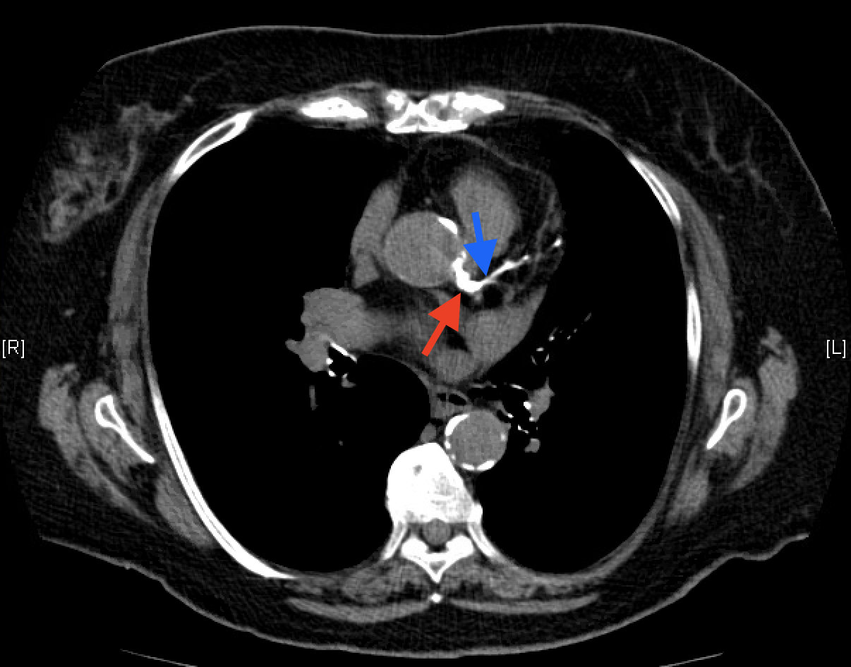
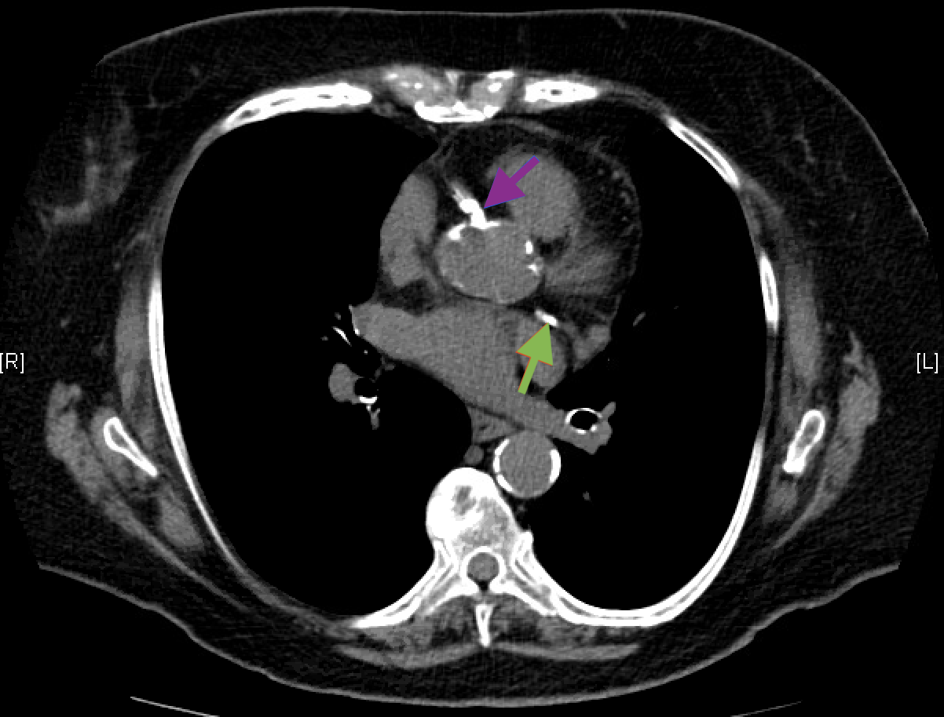
CT Chest Without Contrast
CT chest without contrast also showed significant calcifications of the left main coronary artery (red arrow), proximal left anterior descending artery (blue arrow), circumflex artery (green arrow), and right coronary artery (purple arrow).
Notes:
[Image]
WW Left Main Disease 001c, WW Left Main Disease 001d
[Caption]
CT chest without contrast also showed significant calcifications of the left main coronary artery (red arrow), proximal left anterior descending artery (blue arrow), left circumflex artery (green arrow), and right coronary artery (purple arrow).
[Keywords]
TITLE: CT Chest Without Contrast
Reference Structure: left main coronary artery, proximal left anterior descending artery, left circumflex artery, right main coronary artery
Images: WW Left Main Disease 001c, WW Left Main Disease 001d
Findings: significant calcifications of several coronary arteries
Disease or Diagnosis: multi-vessel coronary artery disease
Complications: acute coronary syndrome, death
Final Diagnosis Path:
Modality and Sequence: CT Chest Without Contrast, axial
Author-Editor: Wanda Wu MS4, Ashley Davidoff MD
Acknowledgements:
Modifiers:

Slide 4
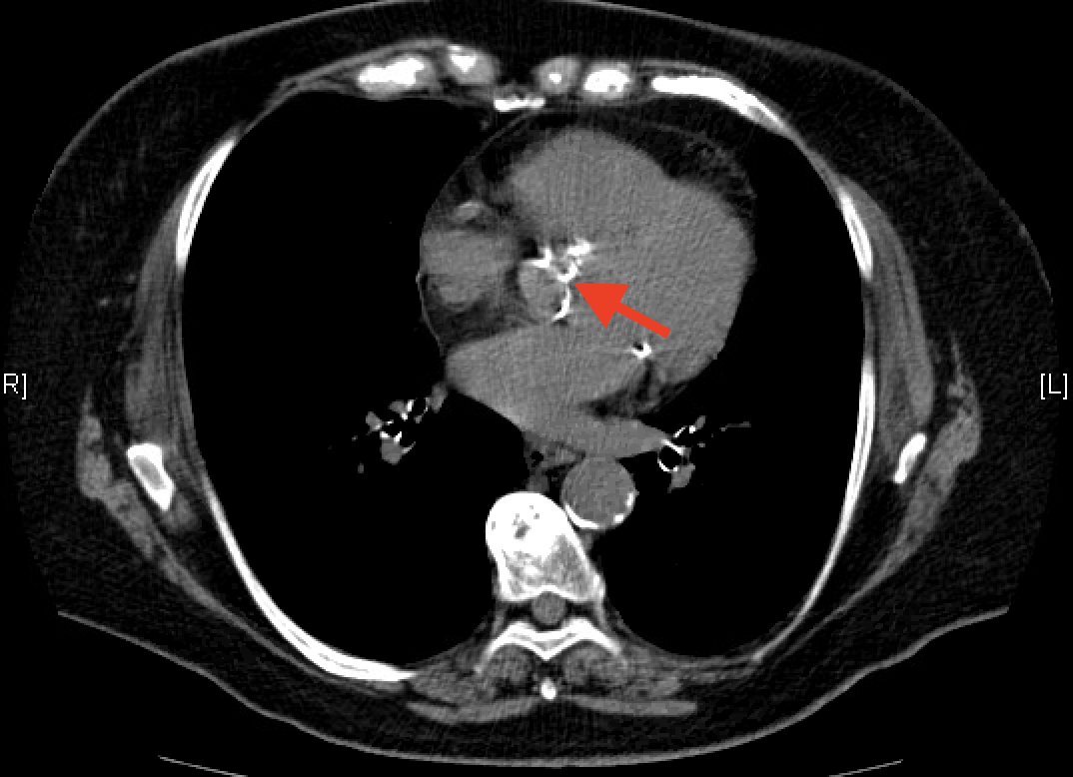
CT Chest Without Contrast
In addition, CT chest in the axial projection at the level of the left inferior pulmonary vein showed moderate calcifications of the aortic valve (red arrow), indicating likely moderately severe aortic valve stenosis.
Notes:
[Image]
WW Left Main Disease 001e
[Caption]
In addition, CT chest in the axial projection at the level of the left inferior pulmonary vein showed moderate calcifications of the aortic valve (red arrow), indicating likely moderately severe aortic valve stenosis.
[Keywords]
TITLE: CT Chest Without Contrast
Reference Structure: aortic valve
Images: WW Left Main Disease 001e
Findings: moderate calcifications of the aortic valve
Disease or Diagnosis: likely moderately severe aortic valve stenosis
Complications: cardiomyopathy, heart failure
Final Diagnosis Path:
Modality and Sequence: CT Chest Without Contrast, axial
Author-Editor: Wanda Wu MS4, Ashley Davidoff MD
Acknowledgements:
Modifiers:

Slide 5
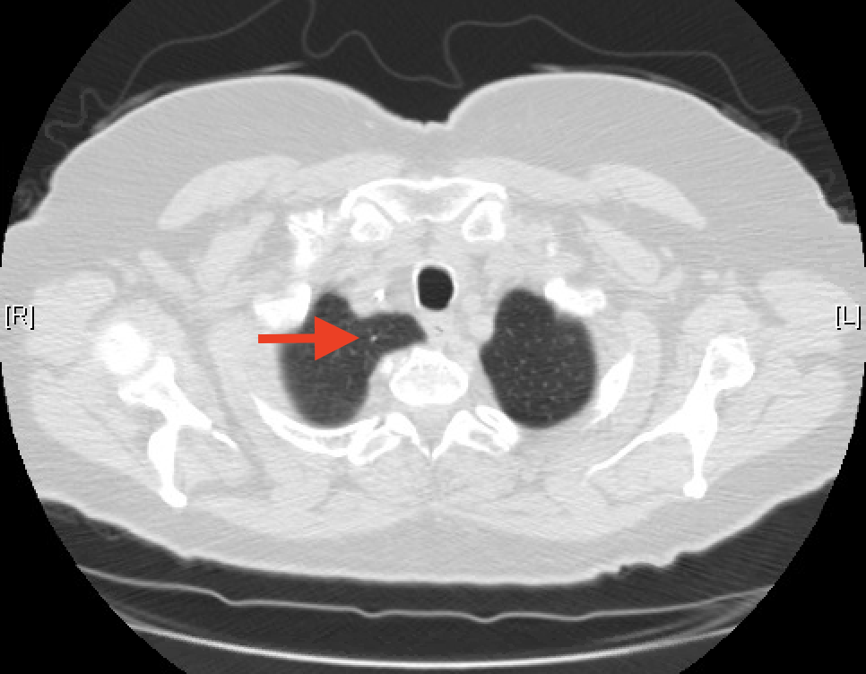
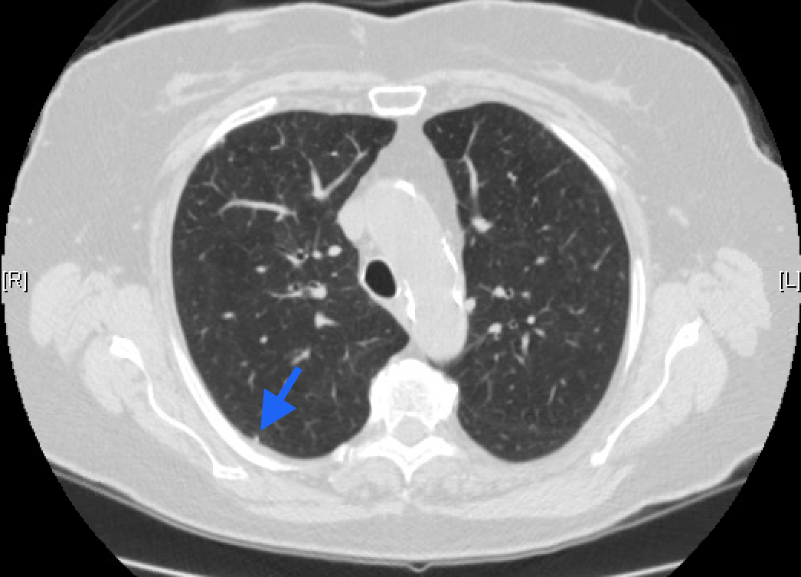
CT Chest Without Contrast Stable Lung Nodules
CT chest without contrast in the axial projections revealed an unchanged 3mm nodule in the right lung apex (red arrow), and several additional smaller nodules including a 2.2mm subpleural nodule in the right upper lobe posteriorly (blue arrow).
Notes:
[Image]
WW Left Main Disease 001a, WW Left Main Disease 001b
[Caption]
CT chest without contrast in the axial projections revealed an unchanged 3mm nodule in the right lung apex (red arrow), and several additional smaller nodules including a 2.2mm subpleural nodule in the right upper lobe posteriorly (blue arrow).
[Keywords]
TITLE: CT Chest Without Contrast
Reference Structure: lung nodules
Images: WW Left Main Disease 001a, WW Left Main Disease 001b
Findings: unchanged lung nodule, several additional lung nodules
Disease or Diagnosis: lung nodules
Complications: often asymptomatic
Final Diagnosis Path:
Modality and Sequence: CT Chest Without Contrast, axial
Author-Editor: Wanda Wu MS4, Ashley Davidoff MD
Acknowledgements:
Modifiers:

Slide 6
Cardiology Referral
Given moderate calcifications of the aortic valve, and significant multi-vessel coronary artery calcifications, a referral to cardiology was placed.
Due to the presence of several cardiovascular risk factors, new onset fatigue and dyspnea on exertion, and imaging evidence of coronary and valvular calcifications on CT, the cardiology team determined that the patient may have extensive coronary artery disease and/or symptomatic aortic valve stenosis.
Therefore, the cardiology team recommended an echo and cardiac catheterization to further characterize valvular function and coronary calcifications, respectively.
Notes:
[Caption]
Given moderate calcifications of the aortic valve, and significant multi-vessel coronary artery calcifications, a referral to cardiology was placed.
Due to the presence of several cardiovascular risk factors, new onset fatigue and dyspnea on exertion, and imaging evidence of coronary and valvular calcifications on CT, the cardiology team determined that the patient may have extensive coronary artery disease and/or symptomatic aortic valve stenosis.
Therefore, the cardiology team recommended an echo and cardiac catheterization to further characterize valvular function and coronary calcifications, respectively.
[Keywords]
TITLE: Cardiology Referral
Reference Structure: coronary arteries, aortic valve
Images:
Findings:
Disease or Diagnosis: multi-vessel coronary artery disease, aortic valve stenosis
Complications:
Final Diagnosis Path:
Modality and Sequence:
Author-Editor: Wanda Wu MS4, Ashley Davidoff MD
Acknowledgements:
Modifiers:

Slide 7
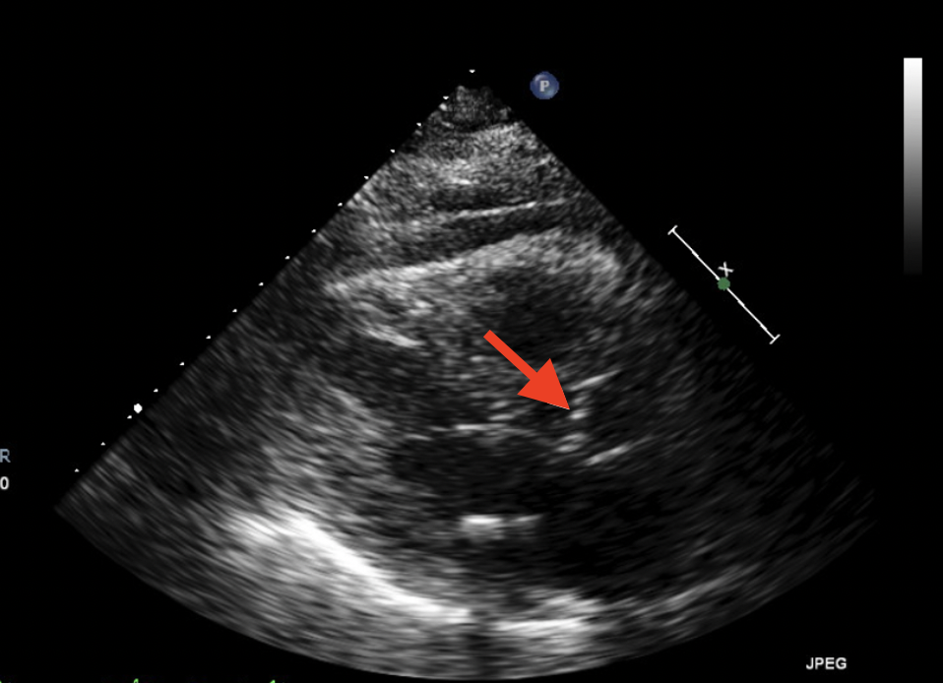
Transthoracic Echocardiogram
Transthoracic echocardiogram in the parasternal short axis view revealed densely calcified aortic valve leaflets with an estimated aortic valve area of 1.1 cm² and peak velocity across valve of 3.3 m/s, findings consistent with moderate aortic valve stenosis.
Notes:
[Image]
WW Left Main Disease 001f
[Caption]
Transthoracic echocardiogram in the parasternal short axis view revealed densely calcified aortic valve leaflets with an estimated aortic valve area of 1.1 cm² and peak velocity across valve of 3.3 m/s, findings consistent with moderate aortic valve stenosis.
[Keywords]
TITLE: Transthoracic Echocardiogram
Reference Structure: aortic valve
Images: WW Left Main Disease 001f
Findings: calcified aortic valve leaflets, decreased aortic valve area
Disease or Diagnosis: moderate aortic valve stenosis
Complications: cardiomyopathy, heart failure, arrhythmias
Final Diagnosis Path:
Modality and Sequence: transthoracic echocardiogram, parasternal short axis view
Author-Editor: Wanda Wu MS4, Ashley Davidoff MD
Acknowledgements:
Modifiers:

Slide 8
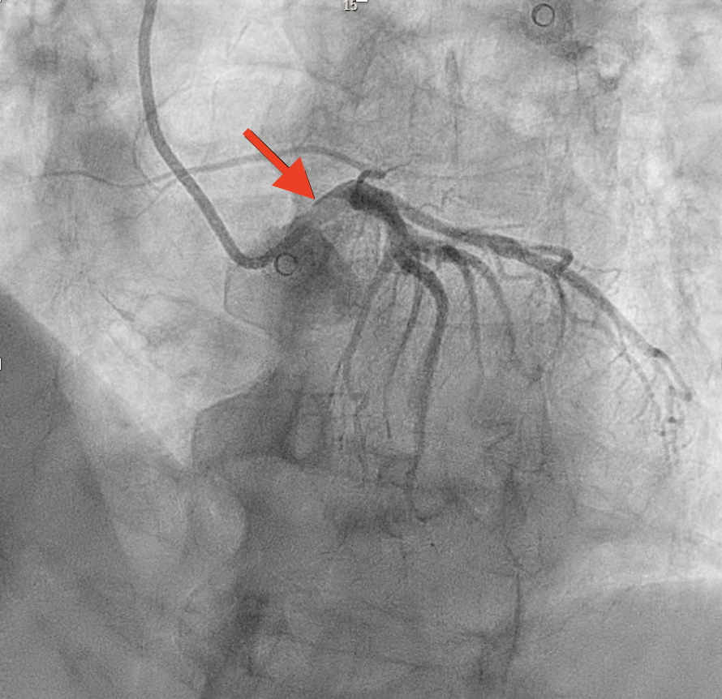
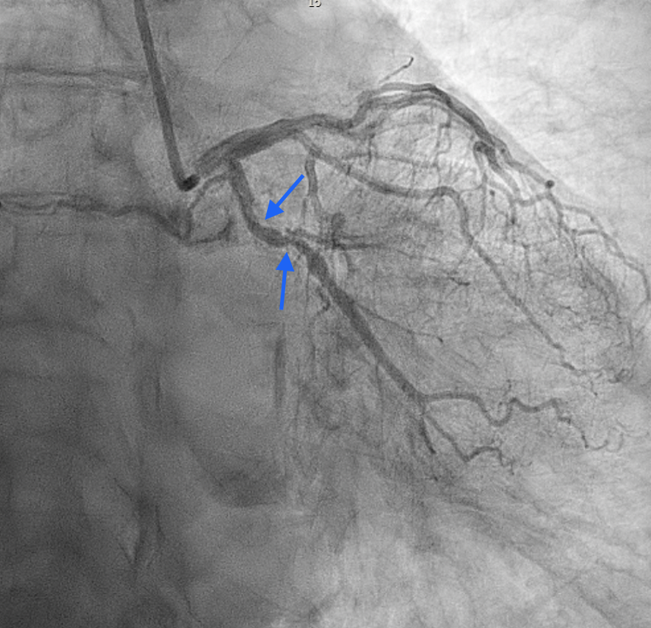
Cardiac Catheterization
Cardiac catheterization in the left anterior oblique-cranial view showed 70% calcified eccentric nodule stenosis of proximal left main coronary artery (red arrow), and the right anterior oblique-caudal view showed 80% stenosis of the mid left circumflex artery (blue arrows), findings consistent with multivessel left-sided coronary artery disease.
Notes:
[Image]
WW Left Main Disease 001g, WW Left Main Disease 001h
[Caption]
Cardiac catheterization in the left anterior oblique-cranial view showed 70% calcified eccentric nodule stenosis of proximal left main coronary artery (red arrow), and the right anterior oblique-caudal view showed 80% stenosis of the mid left circumflex artery (blue arrows).
[Keywords]
TITLE: Cardiac Catheterization
Reference Structure: left main coronary artery, left circumflex artery
Images: WW Left Main Disease 001g, WW Left Main Disease 001h
Findings: significant stenosis of left main and left circumflex arteries
Disease or Diagnosis: left main disease, left-sided coronary artery disease
Complications: angina, acute coronary syndrome, death
Final Diagnosis Path:
Modality and Sequence: cardiac catheterization, LAO-CRA, RAO-CAU
Author-Editor: Wanda Wu MS4, Ashley Davidoff MD
Acknowledgements:
Modifiers:

Slide 9
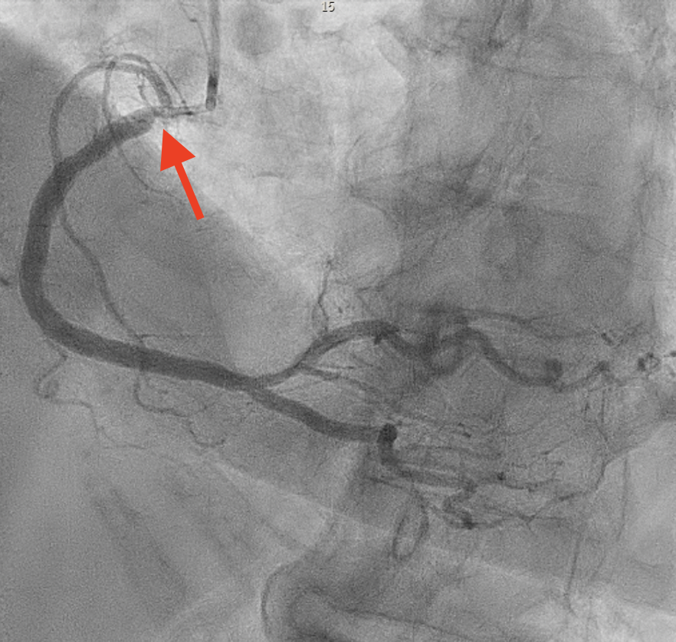
Cardiac Catheterization
In addition, cardiac catherization in the left anterior oblique-cranial view also demonstrated a 70% calcified ostial stenosis of the right coronary artery (red arrow), findings consistent with right-sided coronary artery disease.
Notes:
[Image]
WW Left Main Disease 001i
[Caption]
In addition, cardiac catherization in the left anterior oblique-cranial view also demonstrated a 70% calcified ostial stenosis of the right coronary artery (red arrow), findings consistent with right-sided coronary artery disease.
[Keywords]
TITLE: Cardiac Catheterization
Reference Structure: right coronary artery
Images: WW Left Main Disease 001i
Findings: significant stenosis of right coronary artery
Disease or Diagnosis: right-sided coronary artery disease
Complications: angina, acute coronary syndrome, death
Final Diagnosis Path:
Modality and Sequence: cardiac catheterization, LAO-CRA
Author-Editor: Wanda Wu MS4, Ashley Davidoff MD
Acknowledgements:
Modifiers:

Slide 10
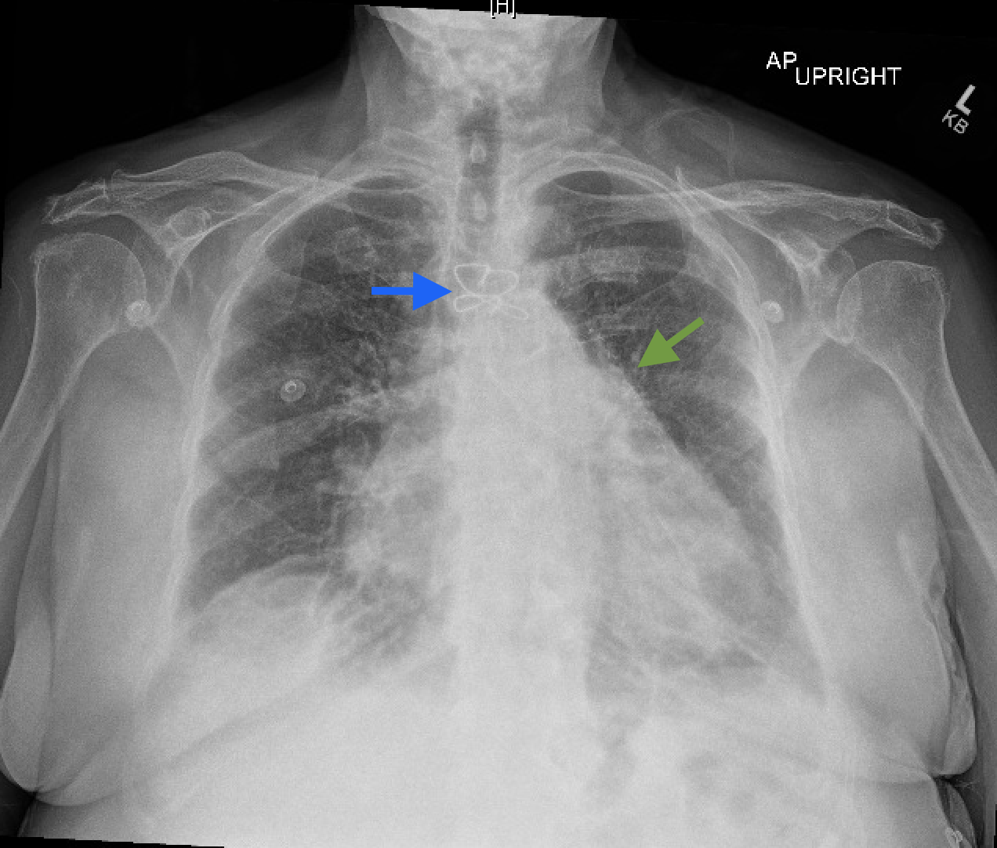
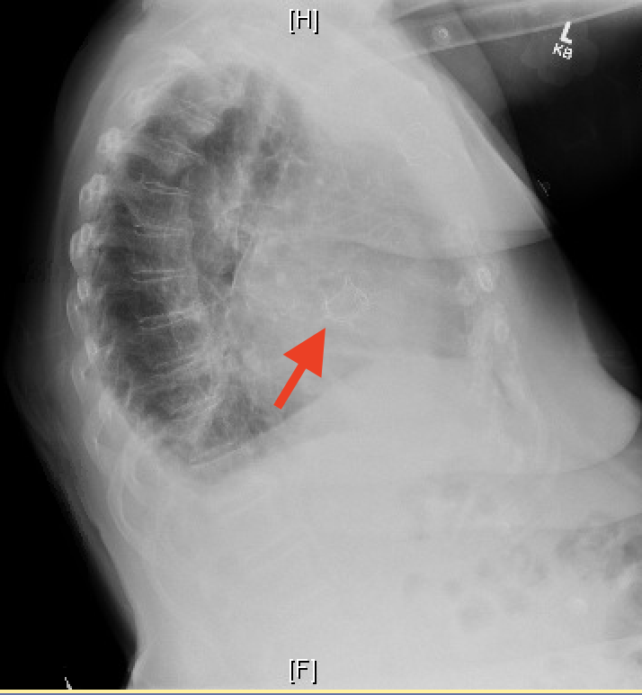
CLINICAL FOLLOW UP
Given the results of significant multi-vessel stenosis shown on cardiac catheterization along with moderate aortic stenosis seen on echo, the patient was scheduled for coronary artery bypass grafting (CABG) with aortic valve replacement (AVR). Patient underwent successful CABG x3 (LIMA-LAD, SVG-PDA-OM sequential) and AVR as evidenced on follow-up chest xray: AVR (red arrow), sternotomy wires (blue arrow), CABG clips (green arrow).
Notes:
[Image]
WW Left Main Disease 001j, WW Left Main Disease 001k
[Caption]
Given the results of significant multi-vessel stenosis shown on cardiac catheterization along with moderate aortic stenosis seen on echo, the patient was scheduled for coronary artery bypass grafting (CABG) with aortic valve replacement (AVR). Patient underwent successful CABG x3 (LIMA-LAD, SVG-PDA-OM sequential) and AVR as evidenced on follow-up chest xray: AVR (red arrow), sternotomy wires (blue arrow), CABG clips (green arrow)
[Keywords]
TITLE: CLINICAL FOLLOW UP
Disease or Diagnosis: multi-vessel CAD and aortic stenosis s/p CABG and AVR
Images: WW Left Main Disease 001j, WW Left Main Disease 001k
Final Diagnosis Path:
Complications: acute coronary syndrome, cardiomyopathy, heart failure

Slide 11
IN A NUTSHELL : Left Main Coronary Artery Disease (Cath)
Major Criteria
≥50% diameter stenosis of left main coronary artery = significant
Minor Criteria
0% = no visible stenosis
1-24% = minimal stenosis
25-49% = mild stenosis
50-69% = moderate stenosis
70-99% = severe stenosis
100% = occlusion
Complications
Angina/acute coronary syndromes (eg. Unstable angina, NSTEMI, STEMI)
Cardiomyopathy/Heart Failure
Arrhythmias
Remember
Extent of coronary calcifications is not necessarily indicative of the extent of coronary stenosis (ie. calcifications ≠ stenosis)
Notes:
[Caption]
Major Criteria
≥50% diameter stenosis of left main coronary artery
Minor Criteria
0% = no visible stenosis
1-24% = minimal stenosis
25-49% = mild stenosis
50-69% = moderate stenosis
70-99% = severe stenosis
100% = occlusion
Complications
Angina/acute coronary syndromes (eg. Unstable angina, NSTEMI, STEMI)
Cardiomyopathy/Heart Failure
Arrhythmias
Remember
Extent of coronary calcifications is not necessarily indicative of the extent of coronary stenosis (ie. calcifications ≠ stenosis)
[Keywords]
TITLE: IN A NUTSHELL : Left Main Coronary Artery Disease (Cath)
Reference Structure: left main coronary artery
Image number: n/a
Findings: n/a
Disease or Diagnosis: left main coronary artery disease
Complications: acute coronary syndromes, death
Final Diagnosis Path: n/a
Modality and Sequence: Cardiac Catheterization
Author-Editor: Wanda Wu Ashley Davidoff MD
Acknowledgements:
Modifiers:

Slide 12
OLA
Which of the following coronary arteries is most commonly occluded?
Left Circumflex
Left Main
Left Anterior Descending
Right Main
Posterior Descending
Smith, L., Bickle, I. Left anterior descending artery. Reference article, Radiopaedia.org. (accessed on 6 Dec 2021) https://doi.org/10.53347/rID-35317
Notes:
[Caption]
Which of the following coronary arteries is most commonly occluded?
Left Circumflex
Left Main
Left Anterior Descending
Right Main
Posterior Descending
C) Left Anterior Descending – the LAD is the most commonly occluded coronary artery. It supplies the anterolateral portion of the myocardium including the apex and the anterior two-thirds of the interventricular septum.
Smith, L., Bickle, I. Left anterior descending artery. Reference article, Radiopaedia.org. (accessed on 6 Dec 2021) https://doi.org/10.53347/rID-35317
[Keywords] TITLE: OLA
Reference Structure: Coronary Arteries, LAD
Images:
Finding:
Disease or Diagnosis: coronary artery disease
Complications: acute coronary events, death
Final Diagnosis Path:
Modality and Sequence:
Author-Editor: Wanda Wu MS4, Ashley Davidoff MD Acknowledgements: Modifiers:

Slide 13
OLA
In general, spotty calcification (as opposed to extensive calcification) of the coronary arteries is more commonly associated with which of the following?
Hypertension
Long-term statin therapy
Plaque instability
Decreased risk of acute coronary syndrome (eg. STEMI, NSTEMI)
Mori H, Torii S, Kutyna M, Sakamoto A, Finn AV, Virmani R. Coronary Artery Calcification and its Progression: What Does it Really Mean? JACC Cardiovasc Imaging. 2018 Jan;11(1):127-142. doi: 10.1016/j.jcmg.2017.10.012. PMID: 29301708.
Faggiano P, Dasseni N, Gaibazzi N, et al. Cardiac calcification as a marker of subclinical atherosclerosis and predictor of cardiovascular events: a review of the evidence. Eur J Prev Cardiol 2019;26:1191–204
Notes:
[Caption]
In general, spotty calcification (as opposed to extensive calcification) of the coronary arteries is more commonly associated with which of the following?
Hypertension
Long-term statin therapy
Plaque instability
Decreased risk of acute coronary syndrome (eg. STEMI, NSTEMI)
C) Plaque instability – Spotty calcification is generally more associated with plaque vulnerability and unstable plaque such as increased risk of plaque rupture, while extensive calcification is more associated with plaque stability and long-term statin therapy (answer choice B). As such, spotty calcification is also associated with increased risk of acute coronary syndrome (answer choice D). More studies are needed to elucidate the association between hypertension and distribution of coronary calcification (answer choice A).
Mori H, Torii S, Kutyna M, Sakamoto A, Finn AV, Virmani R. Coronary Artery Calcification and its Progression: What Does it Really Mean? JACC Cardiovasc Imaging. 2018 Jan;11(1):127-142. doi: 10.1016/j.jcmg.2017.10.012. PMID: 29301708.
Faggiano P, Dasseni N, Gaibazzi N, et al. Cardiac calcification as a marker of subclinical atherosclerosis and predictor of cardiovascular events: a review of the evidence. Eur J Prev Cardiol 2019;26:1191–204
[Keywords] TITLE: OLA
Reference Structure: coronary arteries
Images:
Finding:
Disease or Diagnosis: coronary artery disease
Complications: acute coronary syndrome, death
Final Diagnosis Path:
Modality and Sequence:
Author-Editor: Wanda Wu MS4, Ashley Davidoff MD Acknowledgements: Modifiers:

Slide 14
OLA
Which one of the following is NOT an indication for coronary artery bypass grafting (CABG) over percutaneous coronary intervention (PCI) for patients with coronary artery disease?
Left Main Disease With SYNTAX Score >32
3-Vessel Disease With SYNTAX Score 23-32
Diabetic with 2-Vessel Disease
Two-Vessel Disease Without Proximal LAD Stenosis
Head SJ, Milojevic M, Daemen J, et al. Mortality after coronary artery bypass grafting versus percutaneous coronary intervention with stenting for coronary artery disease: a pooled analysis of individual patient data. Lancet 2018;391:939-48.
Smith SC Jr, Dove JT, Jacobs AK, Kennedy JW, Kereiakes D, Kern MJ, Kuntz RE, Popma JJ, Schaff HV, Williams DO, Gibbons RJ, Alpert JP, Eagle KA, Faxon DP, Fuster V, Gardner TJ, Gregoratos G, Russell RO, Smith SC Jr; American College of Cardiology/American Heart Association task force on practice guidelines (Committee to revise the 1993 guidelines for percutaneous transluminal coronary angioplasty); Society for Cardiac Angiography and Interventions. ACC/AHA guidelines for percutaneous coronary intervention (revision of the 1993 PTCA guidelines)-executive summary: a report of the American College of Cardiology/American Heart Association task force on practice guidelines (Committee to revise the 1993 guidelines for percutaneous transluminal coronary angioplasty) endorsed by the Society for Cardiac Angiography and Interventions. Circulation. 2001 Jun 19;103(24):3019-41. doi: 10.1161/01.cir.103.24.3019. PMID: 11413094.
Notes:
[Caption]
Which one of the following is NOT an indication for coronary artery bypass grafting (CABG) over percutaneous coronary intervention (PCI) for patients with coronary artery disease?
Left Main Disease With SYNTAX Score >32
3-Vessel Disease With SYNTAX Score 23-32
Diabetic with 2-Vessel Disease
Two-Vessel Disease Without Proximal LAD Stenosis
D) Two-Vessel Disease Without Proximal LAD Stenosis – In patients without diabetes and with one or two-vessel disease without proximal LAD stenosis, PCI would be preferred to CABG as it is deemed equally effective and less invasive. Patients with significant or complex left main disease are recommended CABG over PCI (answer choice A). Patients with 3-vessel disease with moderate to high SYNTAX scores are recommended CABG over PCI (answer choice B). CABG is generally preferred to PCI in diabetic patients with multivessel disease as recent studies have shown some mortality benefit of CABG over PCI in these patients (answer choice C).
Head SJ, Milojevic M, Daemen J, et al. Mortality after coronary artery bypass grafting versus percutaneous coronary intervention with stenting for coronary artery disease: a pooled analysis of individual patient data. Lancet 2018;391:939-48.
Smith SC Jr, Dove JT, Jacobs AK, Kennedy JW, Kereiakes D, Kern MJ, Kuntz RE, Popma JJ, Schaff HV, Williams DO, Gibbons RJ, Alpert JP, Eagle KA, Faxon DP, Fuster V, Gardner TJ, Gregoratos G, Russell RO, Smith SC Jr; American College of Cardiology/American Heart Association task force on practice guidelines (Committee to revise the 1993 guidelines for percutaneous transluminal coronary angioplasty); Society for Cardiac Angiography and Interventions. ACC/AHA guidelines for percutaneous coronary intervention (revision of the 1993 PTCA guidelines)-executive summary: a report of the American College of Cardiology/American Heart Association task force on practice guidelines (Committee to revise the 1993 guidelines for percutaneous transluminal coronary angioplasty) endorsed by the Society for Cardiac Angiography and Interventions. Circulation. 2001 Jun 19;103(24):3019-41. doi: 10.1161/01.cir.103.24.3019. PMID: 11413094.
[Keywords] TITLE: OLA
Reference Structure: coronary arteries
Images:
Finding:
Disease or Diagnosis: coronary artery disease
Complications: acute coronary syndrome, death
Final Diagnosis Path:
Modality and Sequence:
Author-Editor: Wanda Wu MS4, Ashley Davidoff MD Acknowledgements: Modifiers:

Slide 15
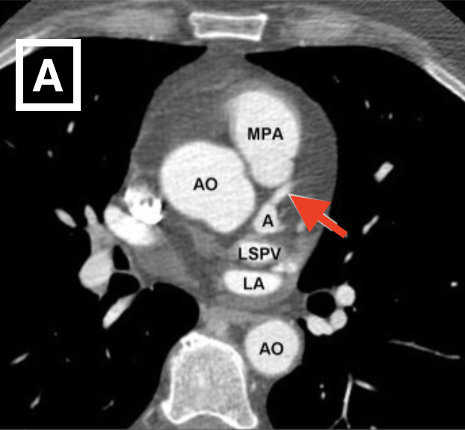
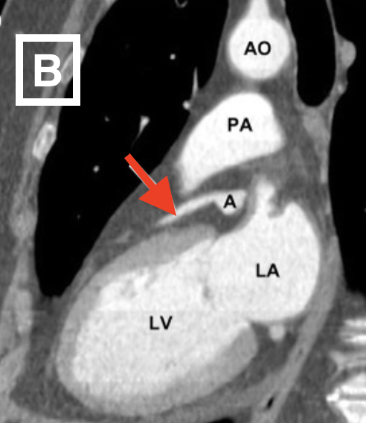
Imaging Spectrum: CTA Coronary Artery Aneurysm
Contrast-enhanced CT in the axial projection (A) and sagittal oblique plane (B) revealing a dilated left anterior descending artery (red arrows). Findings are consistent with a coronary artery aneurysm. A aneurysm, AO aorta, PA pulmonary artery, LA left atrium, LSPV left superior pulmonary vein.
Images courtesy of: Krueger M, Cronin P, Sayyouh M, Kelly AM. Significant incidental cardiac disease on thoracic CT: what the general radiologist needs to know. Insights Imaging. 2019;10(1):10. Published 2019 Feb 6. doi:10.1186/s13244-019-0693-y
Notes:
[Image] Web Image
[Caption]
Contrast-enhanced CT in the axial projection and sagittal oblique plane revealing a dilated left anterior descending artery (red arrows). Findings are consistent with a coronary artery aneurysm. A aneurysm, AO aorta, PA pulmonary artery, LA left atrium, LSPV left superior pulmonary vein.
[Keywords]
TITLE: Imaging Spectrum: CTA Coronary Artery Aneurysm
Reference Structure: left anterior descending artery
Findings: dilation of left anterior descending artery
Disease or Diagnosis: left anterior descending artery aneurysm
Complications: rupture
Final Diagnosis Path:
Modality and Sequence: CTA
Author-Editor: Wanda Wu MS4 and Ashley Davidoff MD
Acknowledgements: Images courtesy of: Krueger M, Cronin P, Sayyouh M, Kelly AM. Significant incidental cardiac disease on thoracic CT: what the general radiologist needs to know. Insights Imaging. 2019;10(1):10. Published 2019 Feb 6. doi:10.1186/s13244-019-0693-y Modifiers:

Slide 16
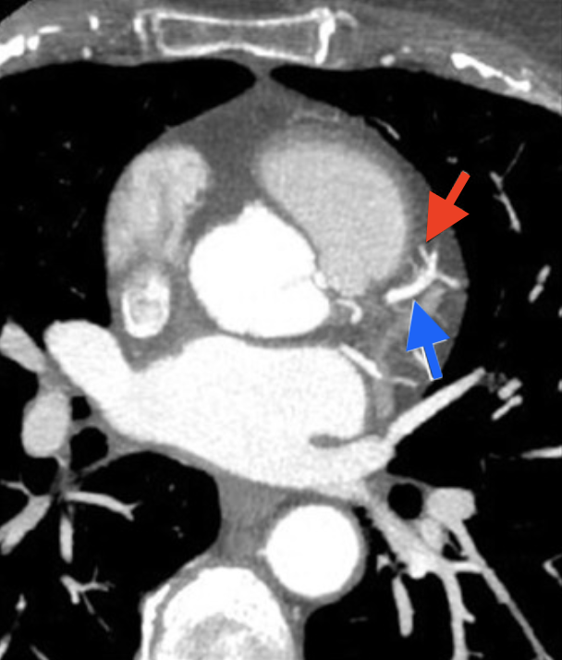
Imaging Spectrum: CTA Coronary Artery Fistula
Contrast-enhanced CT in the axial projection at the level of the pulmonary veins revealing a coronary artery fistula (red arrow) arising from the left anterior descending artery (blue arrow) and eventually emptying into the main pulmonary artery (not pictured).
Image Courtesy of: Krueger M, Cronin P, Sayyouh M, Kelly AM. Significant incidental cardiac disease on thoracic CT: what the general radiologist needs to know. Insights Imaging. 2019;10(1):10. Published 2019 Feb 6. doi:10.1186/s13244-019-0693-y
Notes:
[Image] Web Image
[Caption]
Contrast-enhanced CT in the axial projection at the level of the pulmonary veins revealing a coronary artery fistula (red arrow) arising from the left anterior descending artery (blue arrow) and eventually emptying into the main pulmonary artery (not pictured).
[Keywords]
TITLE: Imaging Spectrum: CTA Coronary Artery Fistula
Reference Structure: left anterior descending artery
Findings: fistula arising from left anterior descending artery
Disease or Diagnosis: coronary artery fistula
Complications: pulmonary hypertension, heart failure
Final Diagnosis Path:
Modality and Sequence: CTA
Author-Editor: Wanda Wu MS4 and Ashley Davidoff MD
Acknowledgements: Image courtesy of: Krueger M, Cronin P, Sayyouh M, Kelly AM. Significant incidental cardiac disease on thoracic CT: what the general radiologist needs to know. Insights Imaging. 2019;10(1):10. Published 2019 Feb 6. doi:10.1186/s13244-019-0693-y Modifiers:

Slide 17
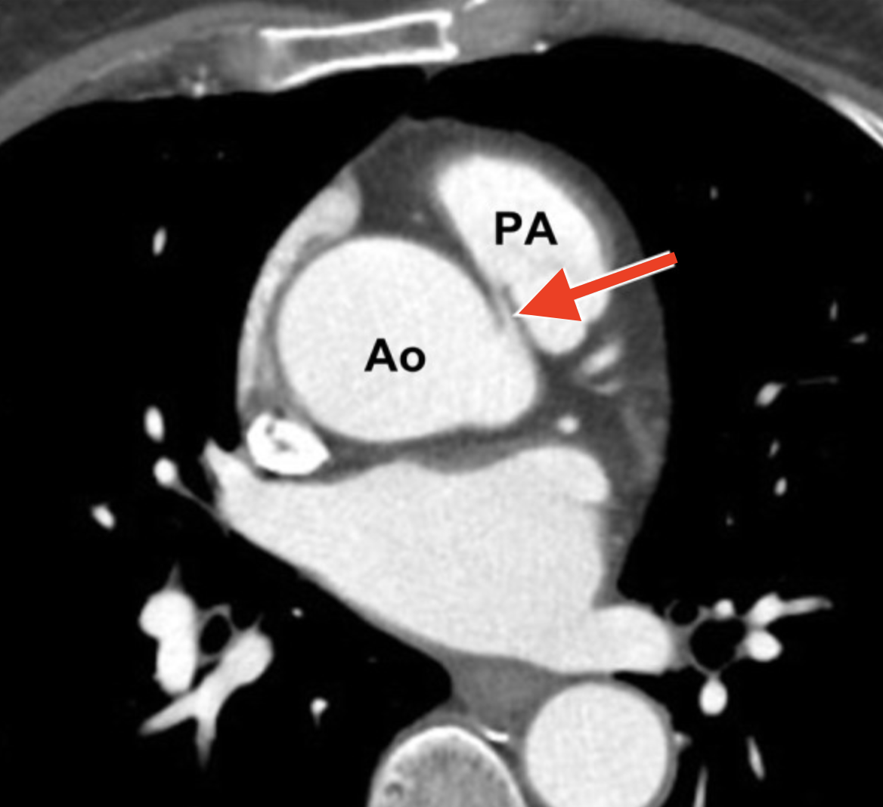
Imaging Spectrum: CTA Anomalous Coronary Artery
Contrast-enhanced CT in the axial projection at the level of the pulmonary artery demonstrates the right coronary artery arising from the left coronary cusp (red arrow). AO aorta, PA pulmonary artery.
Image Courtesy of: Krueger M, Cronin P, Sayyouh M, Kelly AM. Significant incidental cardiac disease on thoracic CT: what the general radiologist needs to know. Insights Imaging. 2019;10(1):10. Published 2019 Feb 6. doi:10.1186/s13244-019-0693-y
Notes:
[Image] Web Image
[Caption]
Contrast-enhanced CT in the axial projection at the level of the pulmonary artery demonstrates the right coronary artery arising from the left coronary cusp (red arrow). AO aorta, PA pulmonary artery.
[Keywords]
TITLE: Imaging Spectrum: CTA Anomalous Coronary Artery
Reference Structure: right coronary artery
Findings: right coronary artery arising from the left coronary cusp
Disease or Diagnosis: anomalous right coronary artery
Complications: ischemia 2/2 ostial occlusion due to angulation or compression, death
Final Diagnosis Path:
Modality and Sequence: CTA
Author-Editor: Wanda Wu MS4 and Ashley Davidoff MD
Acknowledgements: Image courtesy of: Krueger M, Cronin P, Sayyouh M, Kelly AM. Significant incidental cardiac disease on thoracic CT: what the general radiologist needs to know. Insights Imaging. 2019;10(1):10. Published 2019 Feb 6. doi:10.1186/s13244-019-0693-y Modifiers:

Slide 18
DISCUSSION
Although the patient with incidentally found coronary artery calcifications presented in this case ended up having significant coronary stenosis seen on cardiac catheterization requiring 3-vessel CABG, not all patients with evidence of significant coronary calcifications on chest CT will have clinically significant stenosis.
Since the extent of coronary artery calcification does not necessarily indicate the extent of stenosis, incidentally found extensive coronary calcifications seen on chest CT should not automatically entail additional downstream invasive testing such as cardiac catheterization or even a cardiology referral. The patient’s risk factors, symptoms, and clinical history should be taken into consideration along with the incidental findings.
Notes:
[Caption]
Although the patient with incidentally found coronary artery calcifications presented in this case ended up having significant coronary stenosis seen on cardiac catheterization requiring 3-vessel CABG, not all patients with evidence of significant coronary calcifications on chest CT will have clinically significant stenosis.
Since the extent of coronary artery calcification does not necessarily indicate the extent of stenosis, incidentally found extensive coronary calcifications seen on chest CT should not automatically entail additional invasive testing such as cardiac catheterization or even a cardiology referral. The patient’s risk factors, symptoms, and clinical history should be taken into consideration along with the incidental findings.
[Keywords] TITLE: DISCUSSION
Reference Structure: coronary arteries
Images:
Finding:
Disease or Diagnosis: coronary artery disease
Complications: acute coronary syndrome, death
Final Diagnosis Path:
Modality and Sequence:
Author-Editor: Wanda Wu MS4, Ashley Davidoff MD Acknowledgements: Modifiers:

Slide 19
LINKS AND REFERENCES
Bell DJ, Coronary Artery Disease, Radiopaedia.org.
Smith, L., Bickle, I. Left anterior descending artery. Reference article, Radiopaedia.org.
Mori H, Torii S, Kutyna M, Sakamoto A, Finn AV, Virmani R. Coronary Artery Calcification and its Progression: What Does it Really Mean? JACC Cardiovasc Imaging. 2018 Jan;11(1):127-142. doi: 10.1016/j.jcmg.2017.10.012. PMID: 29301708.
Faggiano P, Dasseni N, Gaibazzi N, et al. Cardiac calcification as a marker of subclinical atherosclerosis and predictor of cardiovascular events: a review of the evidence. Eur J Prev Cardiol 2019;26:1191–204
Head SJ, Milojevic M, Daemen J, et al. Mortality after coronary artery bypass grafting versus percutaneous coronary intervention with stenting for coronary artery disease: a pooled analysis of individual patient data. Lancet 2018;391:939-48.
Smith SC Jr, Dove JT, Jacobs AK, Kennedy JW, Kereiakes D, Kern MJ, Kuntz RE, Popma JJ, Schaff HV, Williams DO, Gibbons RJ, Alpert JP, Eagle KA, Faxon DP, Fuster V, Gardner TJ, Gregoratos G, Russell RO, Smith SC Jr; American College of Cardiology/American Heart Association task force on practice guidelines (Committee to revise the 1993 guidelines for percutaneous transluminal coronary angioplasty); Society for Cardiac Angiography and Interventions. ACC/AHA guidelines for percutaneous coronary intervention (revision of the 1993 PTCA guidelines)-executive summary: a report of the American College of Cardiology/American Heart Association task force on practice guidelines (Committee to revise the 1993 guidelines for percutaneous transluminal coronary angioplasty) endorsed by the Society for Cardiac Angiography and Interventions. Circulation. 2001 Jun 19;103(24):3019-41. doi: 10.1161/01.cir.103.24.3019. PMID: 11413094.
Krueger M, Cronin P, Sayyouh M, Kelly AM. Significant incidental cardiac disease on thoracic CT: what the general radiologist needs to know. Insights Imaging. 2019;10(1):10. Published 2019 Feb 6. doi:10.1186/s13244-019-0693-y
Notes:
[Caption]
Bell DJ, Coronary Artery Disease, Radiopaedia.org.
Smith, L., Bickle, I. Left anterior descending artery. Reference article, Radiopaedia.org.
Mori H, Torii S, Kutyna M, Sakamoto A, Finn AV, Virmani R. Coronary Artery Calcification and its Progression: What Does it Really Mean? JACC Cardiovasc Imaging. 2018 Jan;11(1):127-142. doi: 10.1016/j.jcmg.2017.10.012. PMID: 29301708.
Faggiano P, Dasseni N, Gaibazzi N, et al. Cardiac calcification as a marker of subclinical atherosclerosis and predictor of cardiovascular events: a review of the evidence. Eur J Prev Cardiol 2019;26:1191–204
Head SJ, Milojevic M, Daemen J, et al. Mortality after coronary artery bypass grafting versus percutaneous coronary intervention with stenting for coronary artery disease: a pooled analysis of individual patient data. Lancet 2018;391:939-48.
Smith SC Jr, Dove JT, Jacobs AK, Kennedy JW, Kereiakes D, Kern MJ, Kuntz RE, Popma JJ, Schaff HV, Williams DO, Gibbons RJ, Alpert JP, Eagle KA, Faxon DP, Fuster V, Gardner TJ, Gregoratos G, Russell RO, Smith SC Jr; American College of Cardiology/American Heart Association task force on practice guidelines (Committee to revise the 1993 guidelines for percutaneous transluminal coronary angioplasty); Society for Cardiac Angiography and Interventions. ACC/AHA guidelines for percutaneous coronary intervention (revision of the 1993 PTCA guidelines)-executive summary: a report of the American College of Cardiology/American Heart Association task force on practice guidelines (Committee to revise the 1993 guidelines for percutaneous transluminal coronary angioplasty) endorsed by the Society for Cardiac Angiography and Interventions. Circulation. 2001 Jun 19;103(24):3019-41. doi: 10.1161/01.cir.103.24.3019. PMID: 11413094.
Krueger M, Cronin P, Sayyouh M, Kelly AM. Significant incidental cardiac disease on thoracic CT: what the general radiologist needs to know. Insights Imaging. 2019;10(1):10. Published 2019 Feb 6. doi:10.1186/s13244-019-0693-y
[Keywords]
TITLE: LINKS AND REFERENCES
Reference Structure:
Images: n/a
Finding(s): n/a
Disease or Diagnosis:
Complications: n/a
Path: n/a
Modality and Sequence:
Acknowledgements: Modifiers:

